Slide 1
Creating custom VM Images
Mike Stiers SR CONSULTANT
Len Volk SR TECHNICAL SPECIALIST

Slide 2
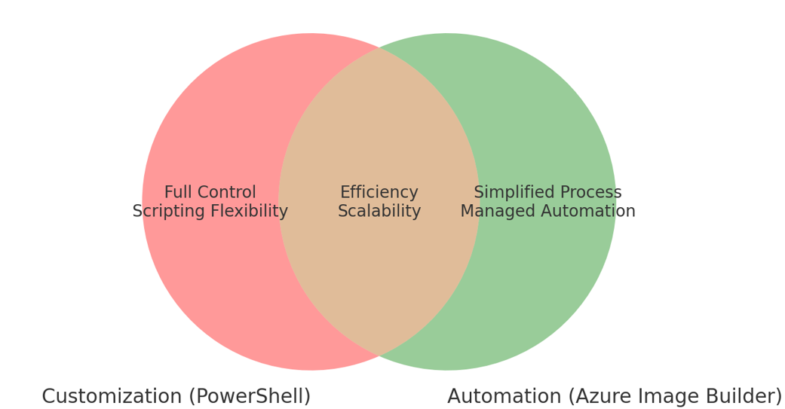
Building Images: Workflow Options in Azure DevOps

Slide 3
Custom Image Pipeline vs Image Builder
Feature | Custom Image Pipeline | Image Builder Service
Based on Marketplace | X | X
Private network access | X | X
Custom software installs | X | X
Image Definition | X | X
Image Gallery | X | X
CI/CD Pipeline | X | X
Image Templating | \ | X
Managed Service |  | X
Full Control | X

Slide 4
Custom Image Pipeline vs Image Builder (continued…)
Custom Image Pipeline
Create Image Definition
Publish to Image Gallery
Create Shared Image Gallery
Prepare Infrastructure
Customization scripts
Image Builder Pipeline
Create Image Definition
Publish to Image Gallery
Create Shared Image Gallery
Apply Image Template

Slide 5
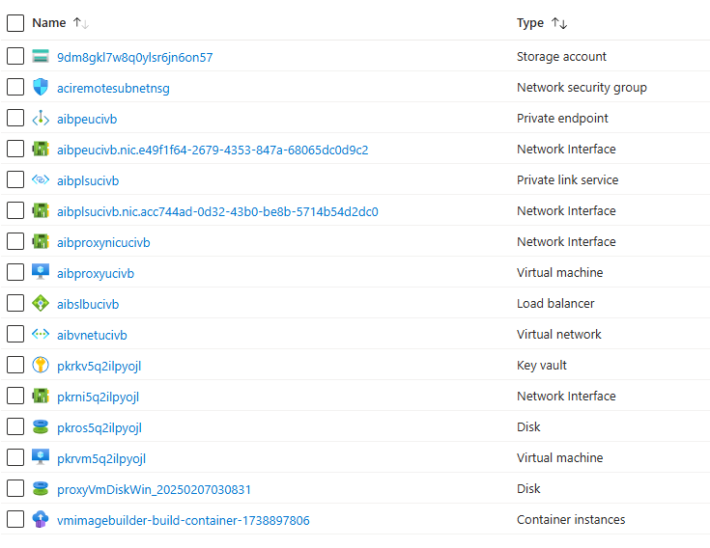
Resources created by Image Builder

Slide 6
Image Builder Template
{
"type": "Microsoft.VirtualMachineImages/imageTemplates",
"apiVersion": "2024-02-01",
"location": "<region>",
"dependsOn": [],
"tags": {
"imagebuilderTemplate": "AIBGoldenImage"
},
"identity": {
"type": "UserAssigned",
"userAssignedIdentities": {
"<imgBuilderId>": {}
}
},
"properties": {
"buildTimeoutInMinutes" : 180,
"source": {
"type": "PlatformImage",
"publisher": "MicrosoftWindowsDesktop",
"offer": "Windows-11",
"sku": "win11-22h2-avd",
"version": "latest"
},
"customize": [
{
"type": "PowerShell",
"name": "Install Choco",
"runElevated": true,
"inline": [
"Set-ExecutionPolicy Bypass -Scope Process -Force",
"[System.Net.ServicePointManager]::SecurityProtocol = [System.Net.ServicePointManager]::SecurityProtocol -bor 3072",
"iex ((New-Object System.Net.WebClient).DownloadString('https://chocolatey.org/install.ps1'))"
]
},
{
Authentication Option
Source Image
Image Customizations

Slide 7
Image Builder Template Customizations
"customize": [
{
"type": "File",
"destination": "string",
"sha256Checksum": "string",
"sourceUri": "string"
},
{
"type": "PowerShell",
"inline": [ "string" ],
"runAsSystem": "bool",
"runElevated": "bool",
"scriptUri": "string",
"sha256Checksum": "string",
"validExitCodes": [ "int" ]
},
{
"type": "Shell",
"inline": [ "string" ],
"scriptUri": "string",
"sha256Checksum": "string"
},
{
"type": "WindowsRestart",
"restartCheckCommand": "string",
"restartCommand": "string",
"restartTimeout": "string"
},
{
"type": "WindowsUpdate",
"filters": [ "string" ],
"searchCriteria": "string",
"updateLimit": "int"
}
]
File
PowerShell
Shell
Windows Restart
Windows Update

Slide 8
References
https://github.com/lenvolk/images-using-azure-image-builder/tree/main/ADOImageBuilder
https://learn.microsoft.com/en-us/azure/virtual-machines/image-builder-overview?tabs=azure-powershell
https://learn.microsoft.com/en-us/azure/virtual-machines/linux/image-builder-json
Microsoft Confidential – Internal Use Only

Slide 9
Packer Template Example (for comparison purposes)
"builders" : [{
"type": "azure-arm",
"client_id": "${client_id}",
"client_secret": "${client_secret}",
"tenant_id": "${tenant_id}",
"subscription_id": "${subscription_id}",
"os_type": "${os_type}",
"image_publisher": "${image_publisher}",
"image_offer": "${image_offer}",
"image_sku": "${image_sku}",
"location": "${location}",
"vm_size": "${vm_size}",
"managed_image_resource_group_name": "${managed_image_resource_group_name}",
"managed_image_name": "${managed_image_name}",
"shared_image_gallery_destination": {
"subscription": "${subscription_id}",
"resource_group": "${resource_group}",
"gallery_name": "${gallery_name}",
"image_name": "${image_name}",
"image_version": "${image_version}",
"replication_regions": "${replication_regions}"
}
}
],
"provisioners": [
{
"type": "ansible",
"playbook_file": "${ansible_playbook_path}"
}
]
}
Builder
Authentication Option
Source Image
Temp VM Size
Custom Managed Image name (end artifact)
To publish the artifact to an Image Gallery
Image Configuration/ Customization

